Slide 1

Covid-19 Impact
correlation between COVID Cases and Distribution of Pitzer Vaccine.
correlation between COVID Cases and Unemployment Rates.
correlation between COVID Cases and Restrictions.
correlation between COVID Cases and Flu Pneumonia
Map the outcome

Slide 2
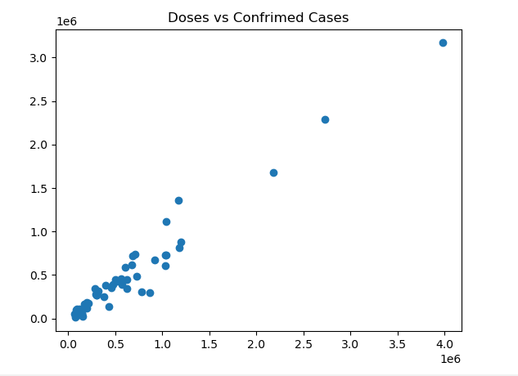
Correlation between COVID Cases and Distribution of Pitzer Vaccine
-Add info for your chart here

Slide 3
Conclusion of the outcome:

Slide 4
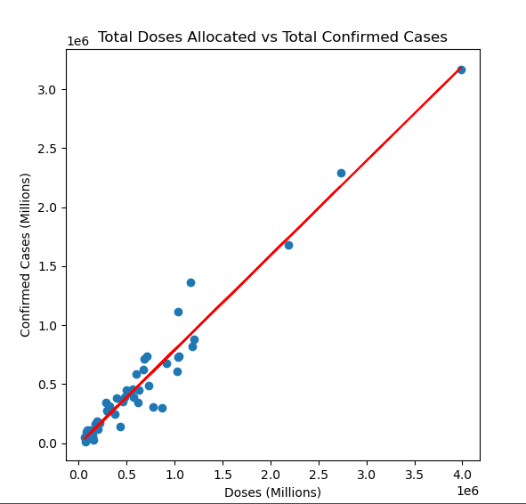
Total Doses Allocated vs Total Confirmed Cases

Slide 5
Conclusion of the outcome:

Slide 6
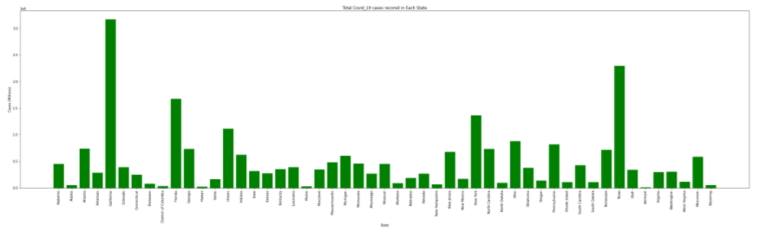
Confirmed Covid-19 per Each State

Slide 7
High Confirmed Covid-19 Cases were in California with 3,169,935 cases. It is higher than the runner up by 875,862 cases which is Texas
Lowest Confirmed Covid-19 Cases were in Vermont with 11,379 cases. It is lower than the runner up by 14,063 cases which is Hawaii

Slide 8
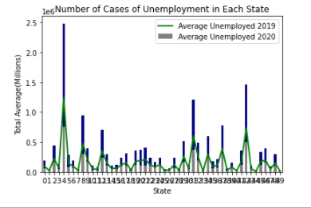
Number of People Unemployed in Each State

Slide 9
Add outcome info here

Slide 10
Airport Passenger vs Population

Slide 11
Add outcome info here

Slide 12
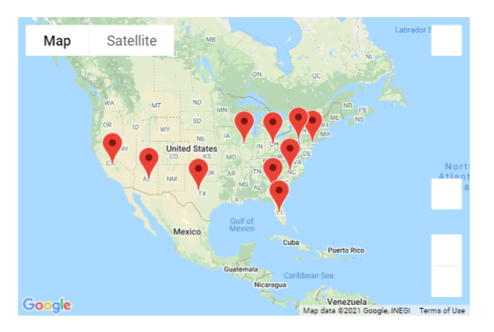
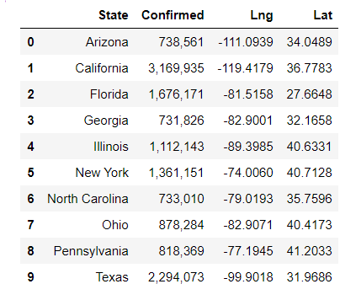
Top 10 Highest Locations of Confirmed Cases

Slide 13
Outcome of mapping

Slide 14
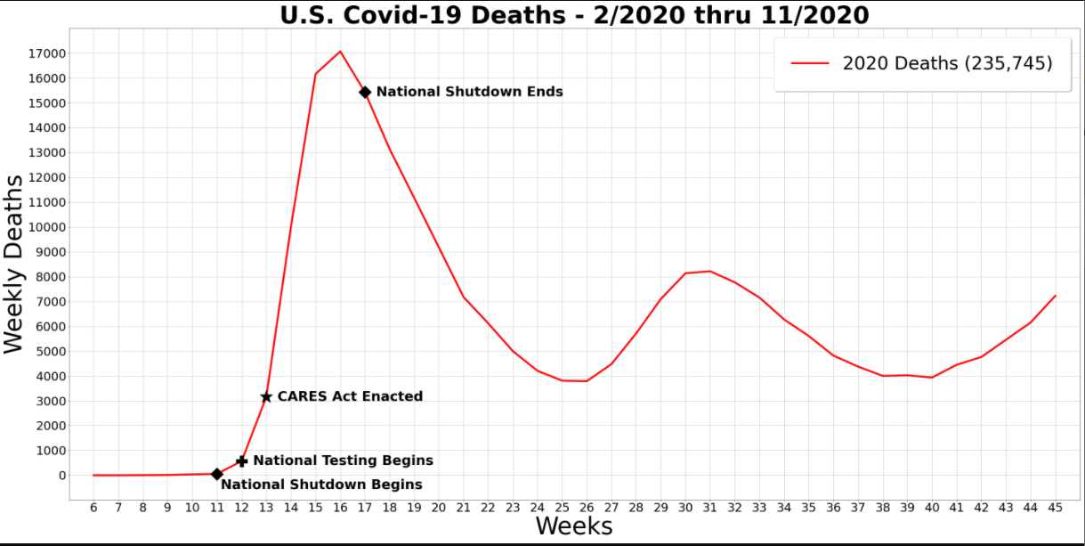

Slide 15
Outcome of mapping

Slide 17
Outcome of mapping

